Slide 1

DATA VALORIZATION
4 November 2021
Machine learning model aimed at timely identifying
faulty water pumps
Gabriele DI BLASIO
Supervising Senior
+39 342 1608025
gabriele.diblasio@sia-partners.com

Slide 2
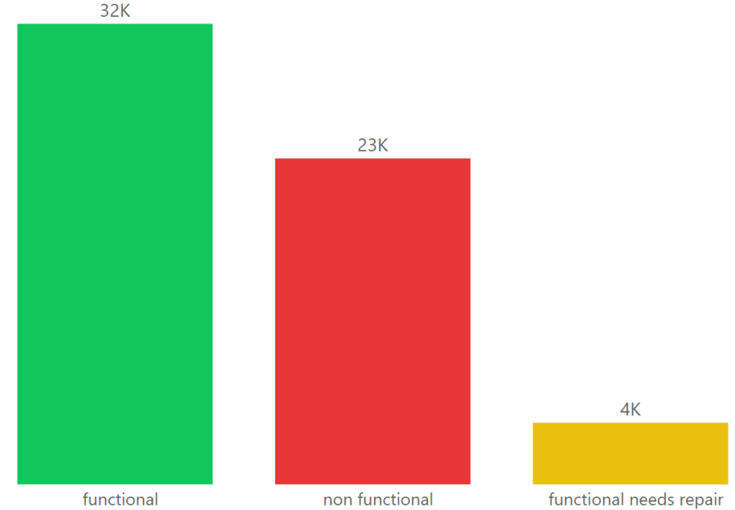
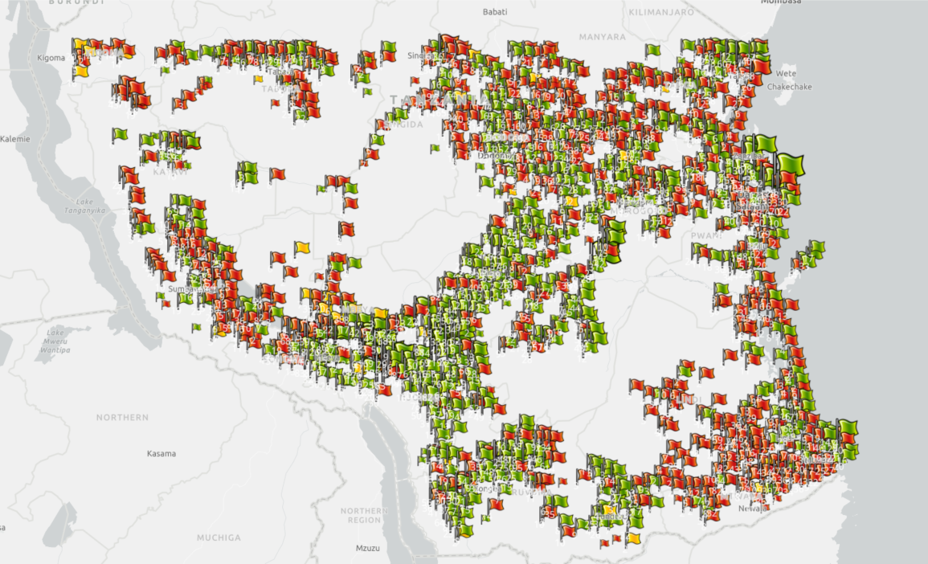

Tanzanian Ministry of Water is struggling with faulty pumps across the country
Out of 59.364 water pumps located across Tanzania, almost 46% are faulty (need some repairs or not working at all)

Slide 3

Sia Partners was engaged to provide concrete answers to the following points
Which drivers can we rely on to identify faulty water pumps in Tanzania
Can we build a model able to timely intercept faulty water pumps
Notes:
VDE

Slide 4




Sia Partners built a pipeline to address these questions
Business issue understanding and study of context
Data cleansing and data transformation in order to properly prepare data for modeling phase
Business insights extraction in order to provide concrete levers to take appropriate actions
Data discovery 30 %
Data prep & modeling 45 %
Insights extraction 25%
15%
15%
25%
20%
25%
Feature analysis from a business and technical point of view, making use of available data dictionaries
Training of model and testing on a validation set

Slide 5


We made sure to build model on quality data and validated the model against data never seen before to verify its ability to generalize rules
Making sure model is learning properly
Training
set
Making sure to provide quality data
Random forest training
Data cleansing on existing features
Target Dataset
Validation set
Train
Labels
Test
Model perfomance assessment on validation set
Feature engineering aimed at creating new powerful predictors
Test set
Generate predictions on water pumps never seen before

Slide 6
Our results prove model is fairly good at classifying water pumps
In-sample accuracy
(on training data)
Random Forest
Out-of-sample accuracy
(on data never seen before)
 | Functional | Functional needs repair | Not functional
Functional | 22.425 | 296 | 403
Not functional | 44 | 2.651 | 46
Functional needs repair | 97 | 73 | 15.521
 | Functional | Functional needs repair | Not functional
Functional | 6.856 | 75 | 127
Not functional | 10 | 807 | 19
Functional needs repair | 30 | 25 | 4.543
Overall accuracy on both is ≈98% meaning 9.8 times on 10 model can accurately predict if water pump is faulty

Slide 7
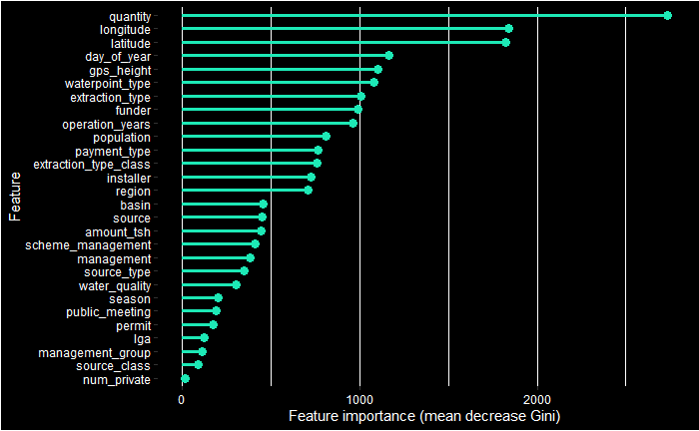
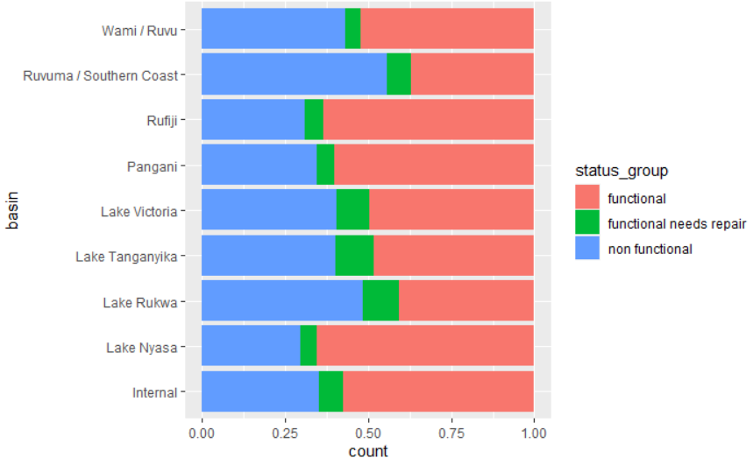
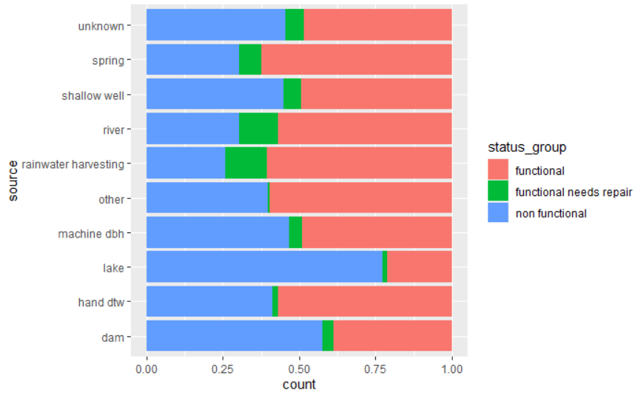
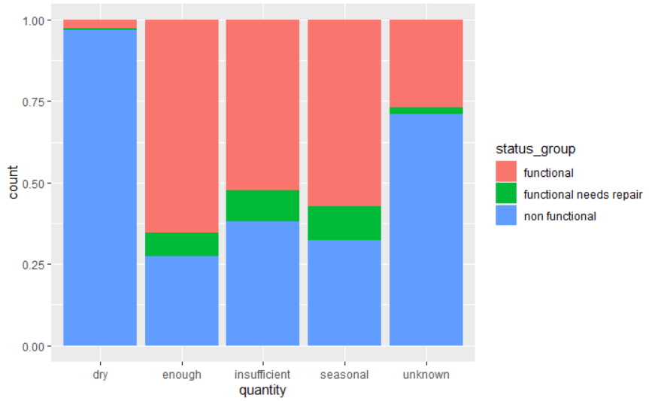

Some water pumps features have very strong predictive power
Geographic features
Waterpoint features
Contextual features

Slide 8
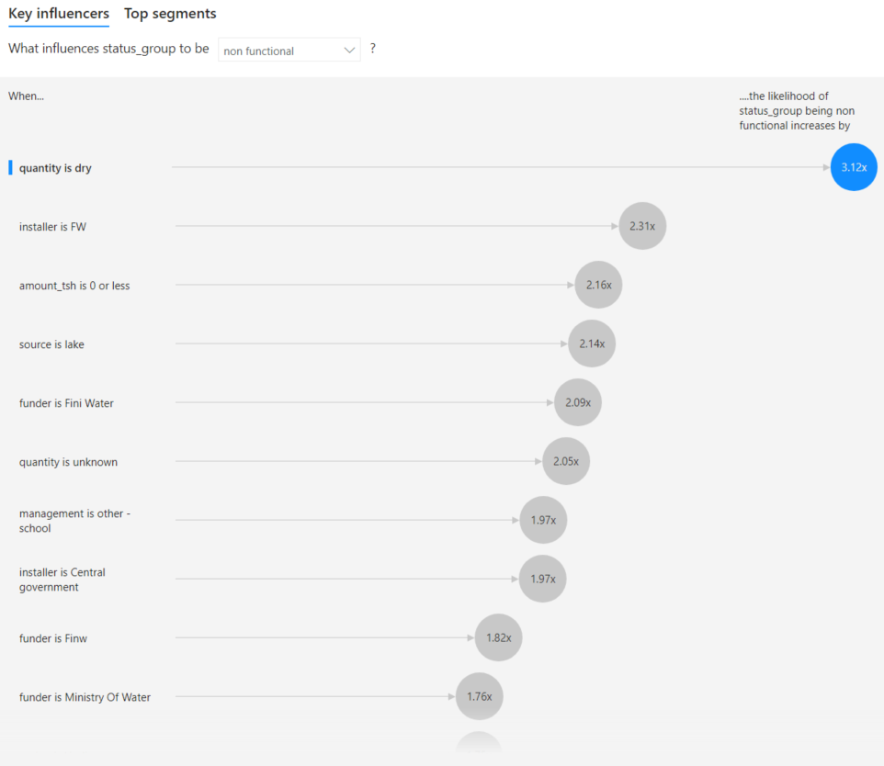
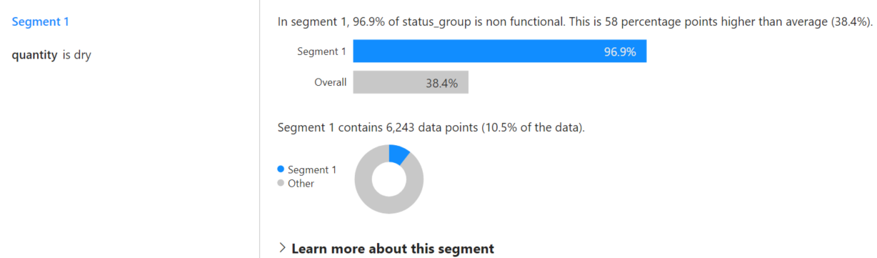
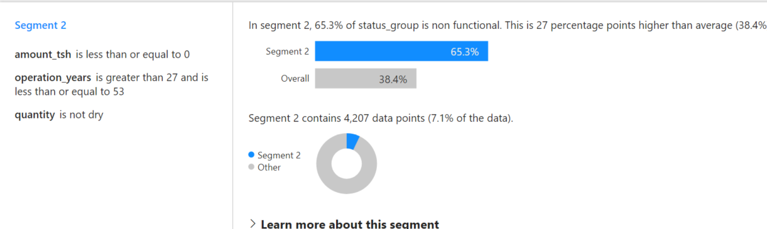
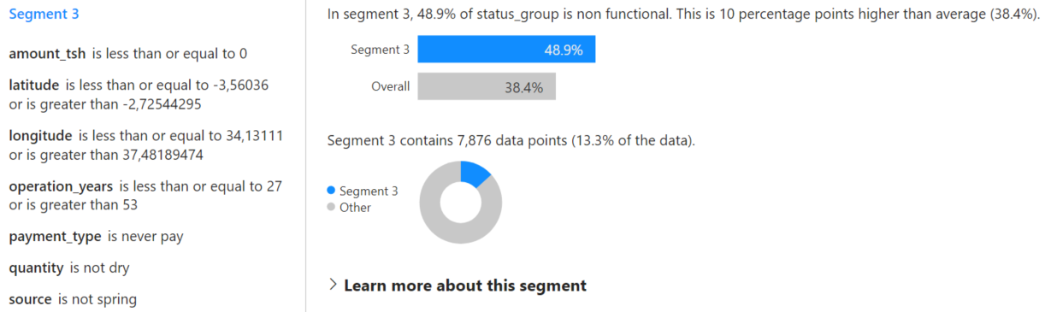
Running an analysis in MS Power BI, Sia Partners was able to identify specific factors contributing to “non functional” status of water pumps
When water pump is dry, water source is a lake, installer or funder is an entity related to central government, the likelihood of pump to be faulty is far higher

Slide 9


Sia Partners has identified some next steps to allow Ministry of Water to extract maximum value from performed activity
1
2
3
Take action based on discussed findings by performing:
Start using model results in order to implement predictive maintenance campaigns aimed at preventing faults;
Perform analytical deep-dives aimed at understanding how geographical and contextual factors influence water pumps status;
Further improve model accuracy and model efficiency by:
Applying undersampling/oversampling techniques to improve accuracy, especially in detecting functional pumps that need some repairs;
Verifying potential accuracy improvement by including features coming from open data (such as weather data);
Test new algorithms in order to compare performance with Random forest and choose the most accurate one;
Industrialize the solution by:
Putting model into production by developing a solid pipeline leveraging a robust infrastructure;
Developing a smart monitoring dashboard aimed at displaying real-time alerts for faulty water pumps.
Short term
Long term

Slide 10
Sia Partners è una next generation consulting firm, che reinventa il mestiere della consulenza portando uno sguardo innovativo e dei risultati concreti ai propri clienti nella trasformazione digitale. La nostra presenza globale e la nostra expertise in più di 30 settori e servizi ci consente di accompagnare numerosi gruppi multinazionali nelle loro iniziative strategiche, con progetti di trasformazione aziendale, strategia IT e digitale e di Data Science. Come Pionieri del Consulting 4.0, sviluppiamo bots e integriamo soluzioni di IA all'interno dei nostri progetti.
Seguici su LinkedIn e registrati sul nostro gruppo: Il Circolo Sia Partners
Seguici su Twitter @SiaPartnersITA
Per maggiori informazioni, visita:

